Slide 1
NEXT HIKES IT SOLUTIONS
PROJECT – Data AnAlysis & Visualisation
NAME- ANKITA MAHAJAN

Slide 2
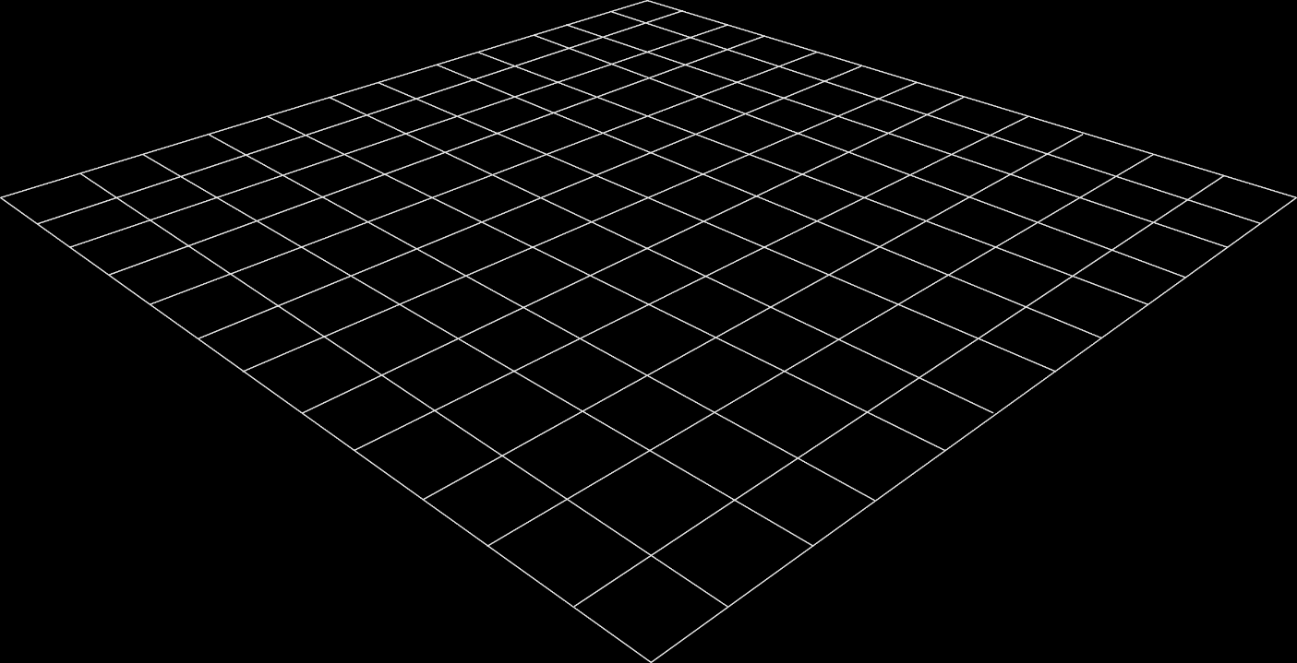
DATaSET-1 & DATASET-2
In this Presentation, I have analyzed Dataset 1& 2, which contains information related to Date, Time, Season and Weather.
The First Step Import Dataset 1 & 2 and Check its Basic Structure, then Identify any Issues, missing values or duplicate values I have found Missing values in Dataset 2 and fill missing values and confirming the dataset is clean and reliable for analysis after analysis I have done Visualization.
MERGE
I have Merged Dataset 1 & Dataset 2 by using Merge Function and Create a New Dataset A. After that I Identify any Issues, missing values or duplicate values and confirming the dataset is clean and reliable for analysis after analysis I have done Visualization.
.

Slide 3
NEW DATASET-A & DATASET-3
I have Import Dataset –A & 3 and Check its Basic Structure, then Identify any Issues, missing values or duplicate values and confirming the dataset is clean and reliable for analysis after analysis I have done Visualization.
MERGE
I have Merged Dataset –A & 3 by using Merge Function and Create Final Data . After that I Identify any Issues, missing values or duplicate values, data type and check outliers , correlation , Skewness , kurtosis and then solve all earrors and confirming the dataset is clean and reliable for analysis after analysis I have done Visualization.

Slide 4
THANK YOU

